Slide 1
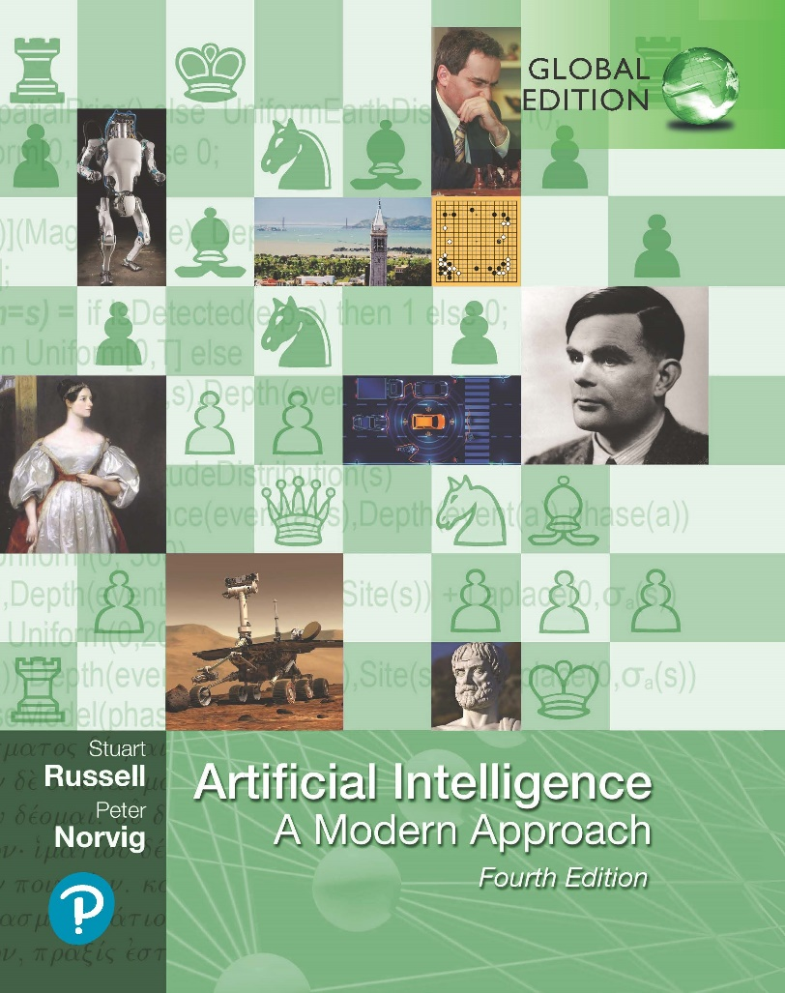
Artificial Intelligence: A Modern Approach
Fourth Edition, Global Edition
Chapter 22
Deep Learning
© 2022 Pearson Education Ltd.

Slide 2
Outline
Simple Feedforward Networks
Computation Graphs for Deep Learning
Convolutional Networks
Learning Algorithms
Generalization
Recurrent Neural Networks
Unsupervised Learning and Transfer Learning
Applications

Slide 3

Simple Feedforward Networks
Feedforward network
connections only in one direction (input to output)
directed acyclic graph with designated input and output nodes
No loops
Recurrent network
its intermediate or final outputs back into its own inputs.
signal values within the network form a dynamical system that has internal state or memory
Networks as complex functions
Each node within a network is called a unit
calculates the weighted sum of the inputs from predecessor nodes
applies a nonlinear function to produce its output
g _{j} is a nonlinear activation function, a _{j} denotes the output of unit j
and w_{i,} _{j} is the weight attached to the link from unit i to unit j;

Slide 4
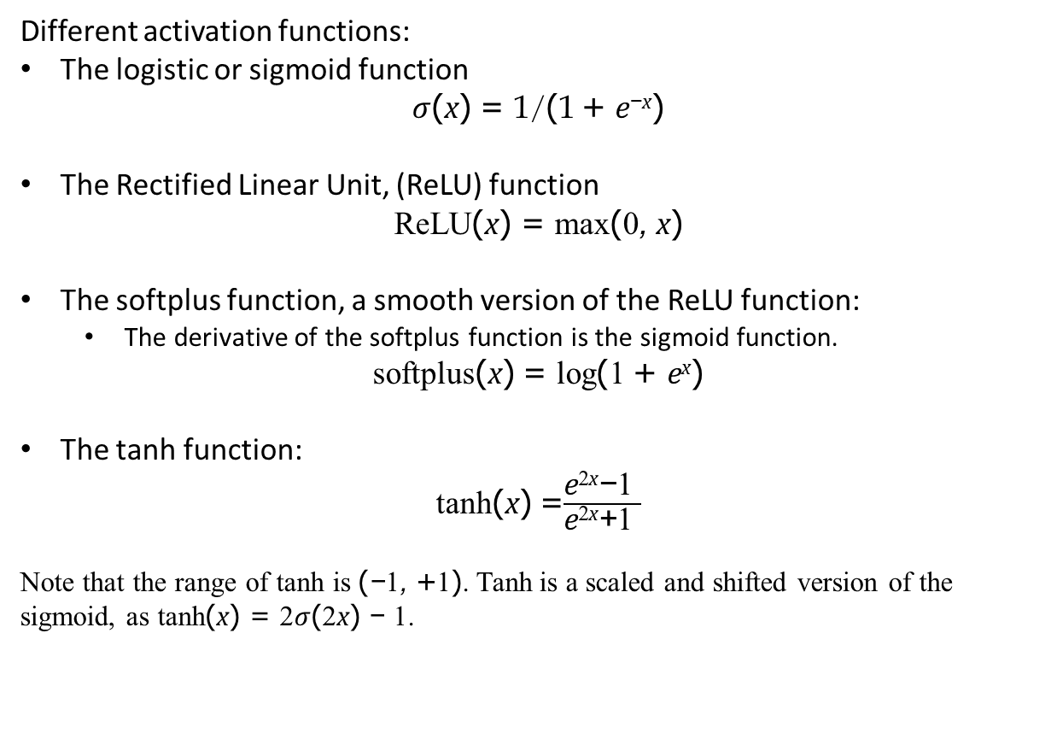
Simple Feedforward Networks
Different activation functions:
The logistic or sigmoid function
$σ$(x) = 1/(1 + e^{−x})
The Rectified Linear Unit, (ReLU) function
ReLU(x) = max(0, x)
The softplus function, a smooth version of the ReLU function:
The derivative of the softplus function is the sigmoid function.
softplus(x) = log(1 + e^{x})
The tanh function:
tanh(x) =$\frac{\text{e}\text{2}\text{x}\text{−}\text{1 }}{\text{e}\text{2}\text{x}\text{+}\text{1 }}$
Note that the range of tanh is (−1, +1). Tanh is a scaled and shifted version of the sigmoid, as tanh(x) = 2$σ$(2x) − 1.

Slide 5
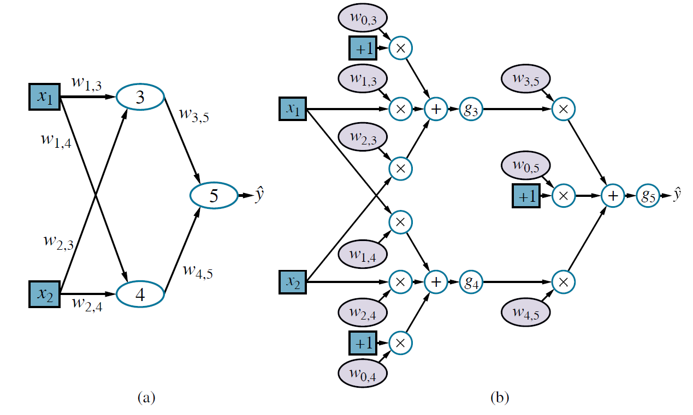
Simple Feedforward Networks
(a) A neural network with two inputs, one hidden layer of two units, and one
output unit. Not shown are the dummy inputs and their associated weights. (b) The network in (a) unpacked into its full computation graph

Slide 6
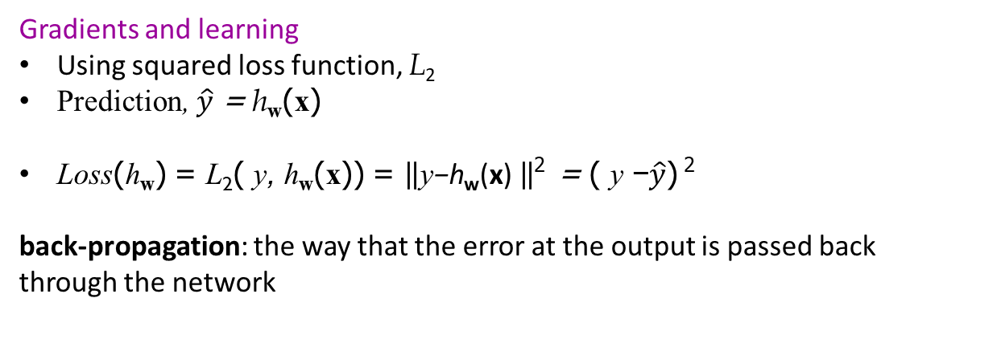
Simple Feedforward Networks
Gradients and learning
Using squared loss function, L₂
Prediction, $\hat{y}$ = h_{w}(x)
Loss(h_{w}) = L₂( y, h_{w}(x)) = $\left\|\text{y}\text{−}\text{h}\text{w}\text{(}\text{x}\text{) }\right\|$² = ( y −$\hat{y}$) ²
back-propagation: the way that the error at the output is passed back
through the network

Slide 7
Computation Graphs for Deep Learning
Input encoding
Input and output nodes of a computational graph are the ones that connect directly to the input data x and the output data y.
False is mapped to an input of 0 and true is mapped to 1, or (-1 and +1)
Numeric attributes used as is
Categorical attributes with more than two values are usually encoded with one-hot encoding.
An attribute with d possible values is represented by d separate input bits.
corresponding input bit is set to 1 and other 0.

Slide 8

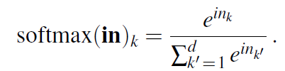
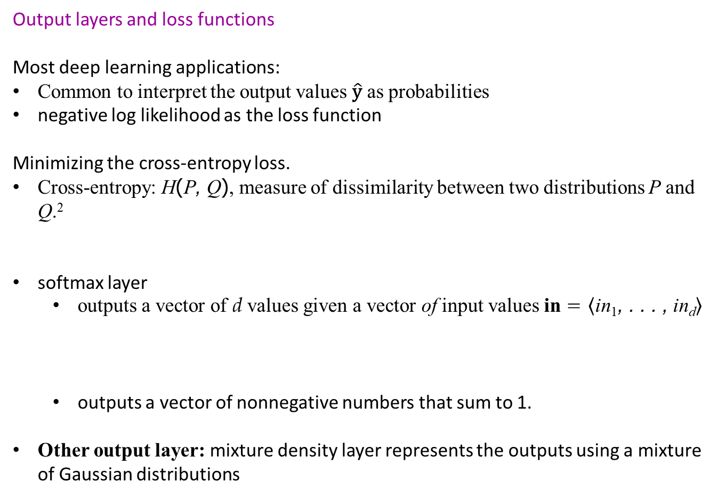
Computation Graphs for Deep Learning
Output layers and loss functions
Most deep learning applications:
Common to interpret the output values $\hat{\text{y}}$ as probabilities
negative log likelihood as the loss function
Minimizing the cross-entropy loss.
Cross-entropy: H(P, Q), measure of dissimilarity between two distributions P and Q.²
softmax layer
outputs a vector of d values given a vector of input values in = $\left\langle \text{in}\text{1}\text{, . . . , }\text{in}\text{d}\right\rangle$
outputs a vector of nonnegative numbers that sum to 1.
Other output layer: mixture density layer represents the outputs using a mixture of Gaussian distributions

Slide 9
Computation Graphs for Deep Learning
Hidden layers
Intermediate computations before producing the output y.
Different representation for the input x.
Each layer transforms the representation produced by the preceding layer to produce a new representation
In the process of forming all these internal transformations, deep networks often discover meaningful intermediate representations of the data
The hidden layers of neural networks are typically less diverse than the output layers.

Slide 10
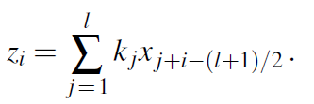
Convolutional Networks
Convolutional neural network (CNN) is one that contains spatially local connections
Kernel: A pattern of weights that is replicated across multiple local regions
Convolution: the process of applying the kernel to the pixels of the image
input vector x of size n, corresponding to n pixels in a one-dimensional image, and a vector kernel k of size l.
convolution operation, z = x ∗ k.
kernels centers are separated distance called stride, s .
convolution stops at the edges of the image, but padding the input with extra pixels is possible so that kernel is applied exactly [n/s] times.

Slide 11
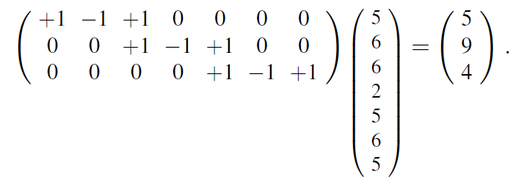
Convolutional Networks
Convolution can be viewed as a matrix multiplication
In this weight matrix, the kernel appears in each row, shifted according to the stride relative to the previous row.
CNNs were inspired originally by models of the visual cortex WHERE the receptive field of a neuron can affect that neuron’s activation.
In a CNN, the receptive field of a unit in the first hidden layer is small (size of kernel)

Slide 12
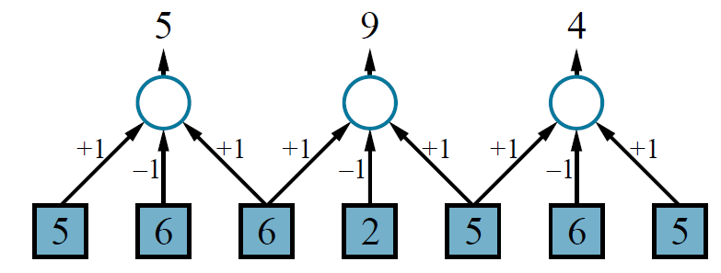
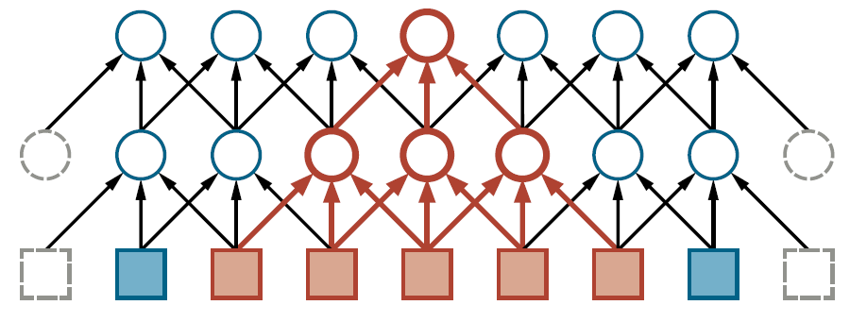
Convolutional Networks
One-dimensional convolution operation with a kernel of size l = 3 and a stride s = 2.
The first two layers of a CNN for a 1D image with a kernel size l = 3 and a stride s = 1. Padding is added at the left and right ends in order to keep the hidden layers the same size as the input.

Slide 13
Convolutional Networks
Pooling and downsampling
A pooling layer in a neural network summarizes a set of adjacent units from the preceding layer with a single value
Common forms of pooling:
Average-pooling: computes the average value of its l inputs
coarsen the resolution of the image, downsample by a factor of s.
10s pixels =10 pixels after pooling.
Classifier can recognize in the pooled image: facilitates multiscale recognition
Max-pooling: computes the maximum value of its l inputs.
Can be used for downsampling
logical disjunction, saying that a feature exists somewhere in the unit’s receptive field.

Slide 14
Convolutional Networks
Tensor operations in CNNs
tensors, which (in deep learning terminology) are simply multidimensional arrays
of any dimension
Vectors and matrices are one-dimensional and two-dimensional special cases of tensors
a way of keeping track of the “shape” of the data as it progresses through the layers of the network
Computational efficiency of tensor operations: given a description of a network as a sequence of tensor operations, deep learning software package can generate compiled code that is highly optimized for the underlying computational substrate
Are run on GPUs (graphics processing units) or TPUs (tensor processing units), which make available a high degree of parallelism

Slide 15
Convolutional Networks
Residual networks
Residual networks avoid the problem of vanishing gradients in typical deep models
Typical deep models: each layer completely replaces the representation from the preceding layer
key idea of residual networks: a layer should perturb the representation from
the previous layer rather than replace it entirely
_{z}^{(i)} _{= g}^{(i)}_{(z}^{(i−1)} _{+ f (z}^{(i−1)}₎₎
z^{(i)} : values of the units in layer i, g_{r} : the eactivation functions for the residual layer
f as the residual, perturbing the default bhavior of passing layer i−1 through to layer i.
A neural network with one linear layer combined with on linear layer:
f (z) = Vg(Wz)
where W and V are learned weight matrices with the usual bias weights added.

Slide 16
Learning Algorithms
Computing gradients in computation graphs
Gradient of the loss function could be computed by back-propagating error information from the output layer of the network to the hidden layers
The back-propagation process passes messages back along each link in the network
The messages are all partial derivatives of the loss L.
∂L/∂h = ∂L/∂h_{j} + ∂L/∂h_{k}
Weight-sharing is handled by treating each shared weight as a single node with multiple outgoing arcs in the computation graph

Slide 17
Learning Algorithms
Computing gradients in computation graphs
The gradient for the shared weight is the sum of the gradient contributions from each place it is used in the network
cost is linear in the number of nodes in the computation graph
all of the gradient computations can be prepared in symbolic form in advance and compiled into very efficient code for each node in the graph.
drawback of back-propagation:
requires storing most of the intermediate values that were computed during forward propagation in order to calculate gradients in the backward pass

Slide 18
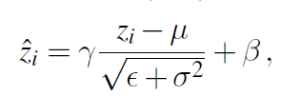
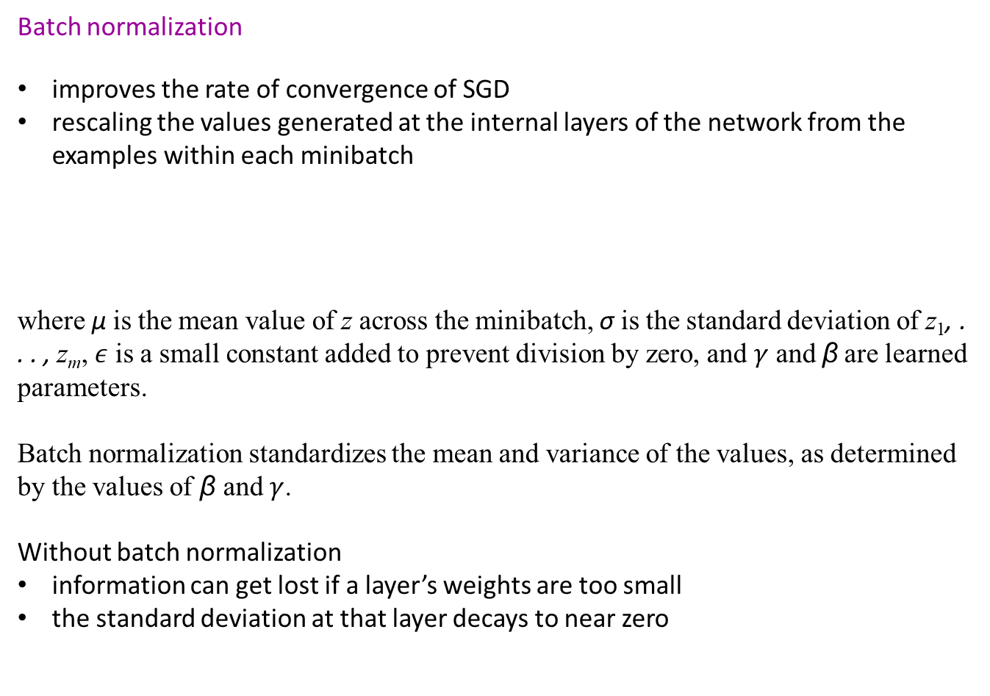
Learning Algorithms
Batch normalization
improves the rate of convergence of SGD
rescaling the values generated at the internal layers of the network from the examples within each minibatch
where µ is the mean value of z across the minibatch, σ is the standard deviation of z₁, . . . , z_{m}, $ε$ is a small constant added to prevent division by zero, and $γ$ and β are learned parameters.
Batch normalization standardizes the mean and variance of the values, as determined by the values of β and$γ$.
Without batch normalization
information can get lost if a layer’s weights are too small
the standard deviation at that layer decays to near zero

Slide 19
Generalization
Choosing a network architecture
Some neural network architectures are explicitly designed to generalize well on particular types of data
When comparing two networks with similar numbers of weights, the deeper network usually gives better generalization performance.
Deep learning systems perform better than any other pure machine learning approaches for high dimensional inputs (images, video, speech signals, etc)
Deep learning models lack the compositional and quantificational expressive power
May also produce unintuitive errors. Tend to produce input–output mappings that are discontinuous

Slide 20
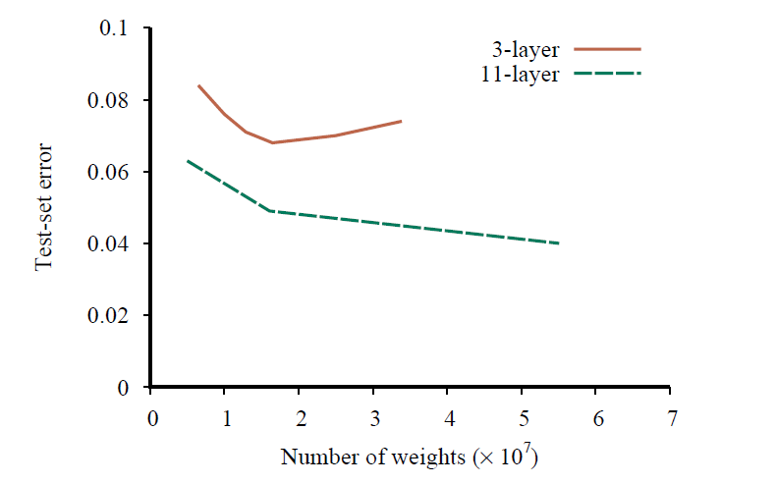
Generalization
Test-set error as a function of layer width (as measured by total number of weights) for three-layer and eleven-layer convolutional networks. The data come from early versions of Google’s system for transcribing addresses in photos taken by Street View cars

Slide 21
Generalization
Neural architecture search
neural architecture search to explore the state space of possible network architectures.
Evolutionary algorithms: recombination (joining parts of two networks together) and mutation (adding or removing a layer or changing a parameter value)
Hill climbing with mutation operations
major challenge is estimating the value of a candidate network
train one big network, search for subgraphs of the network that perform better
heuristic evaluation function

Slide 22
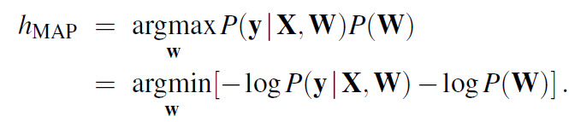
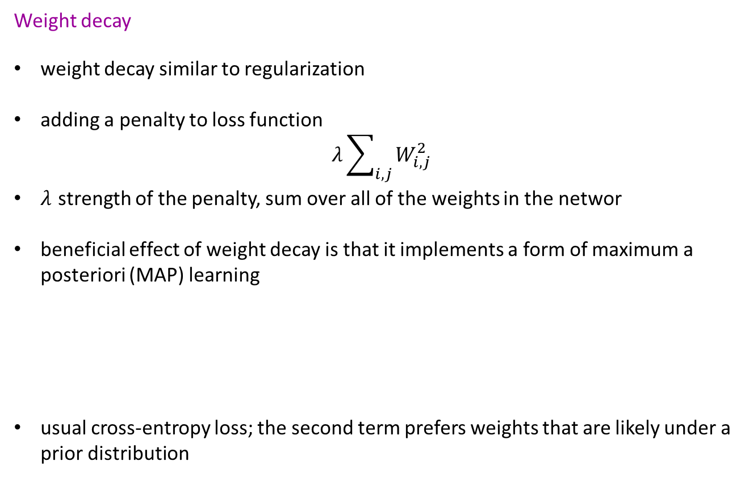
Generalization
Weight decay
weight decay similar to regularization
adding a penalty to loss function
$$λ{\sum_{i,j}^{ }{W_{i,j}^{2}}}_{ }$$
$λ$ strength of the penalty, sum over all of the weights in the networ
beneficial effect of weight decay is that it implements a form of maximum a posteriori (MAP) learning
usual cross-entropy loss; the second term prefers weights that are likely under a prior distribution

Slide 23
Generalization
Dropout
intervene to reduce the test-set error of a network—at the cost of making it harder to fit the training set:
introducing noise at training time, the model is forced to become robust to noise
Hidden units trained with dropout useful & compatible with many other possible sets of other hidden units that may or may not be included in the full model.
dropout approximates the creation of a large ensemble of thinned networks
applied to later layers in a deep network forces the final decision to be made robustly by paying attention to all of the abstract features of the example
dropout forces the model to learn multiple, robust explanations for each input

Slide 24
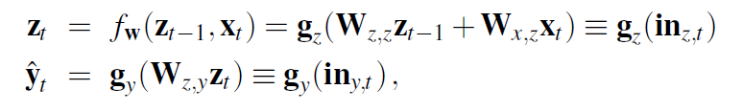
Recurrent Neural Networks
Recurrent neural networks (RNNs) allow cycles in the computation graph
each cycle has a delay
units may take as input a value computed from their own output at an earlier step
RNN has an internal state/memory
RNNs add expressive power compared to feedforward networks,
Training a basic RNN
input layer x, a hidden layer z with recurrent connections, and an output layer y,
g_{z} and g_{y} denote the activation functions for the hidden and output layers, respectively.

Slide 25
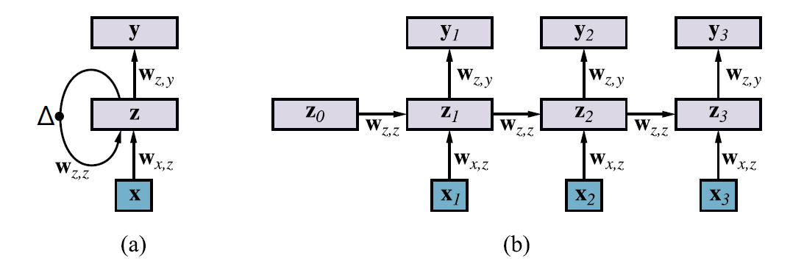
Recurrent Neural Networks
(a) Schematic diagram of a basic RNN where the hidden layer z has recurrent
connections; the ∆ symbol indicates a delay.
(b) The same network unrolled over three time steps to create a feedforward network. Note that the weights are shared across all time steps.

Slide 26
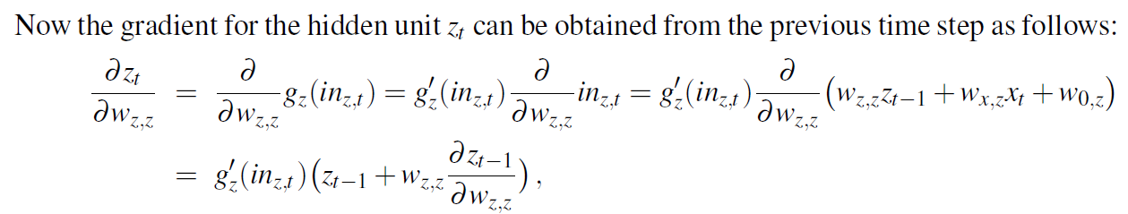
Recurrent Neural Networks
Gradient expression is recursive
Backpropagation through time:
The contribution to the gradient from time step t is calculated using the contribution from time step t − 1.
The total run time for computing the gradient will be linear in the size of the network
For sigmoids, tanhs, and ReLUs, g^{t} 1, so our simple RNN will certainly suffer from the vanishing gradient problem
if w_{z,z} > 1, we may experience the exploding gradient problem.

Slide 27
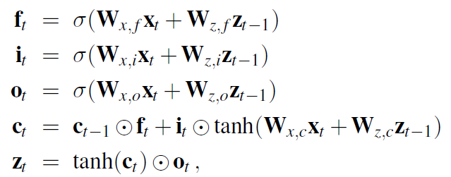
Recurrent Neural Networks
Long short-term memory RNNs
Has a long-term memory component, memory cell (c) copied from time step to time step
Has gating units:
vectors control the flow of information
elementwise multiplication of the corresponding information vector
Types of gating units:
Forget gate f determines if each element of the memory cell is remembered
Input gate i determines if each element of the memory cell is updated additively
Output gate o determines if each element of the memory cell is transferred to the short-term memory z
Gates in LSTM differ from Boolean functions, they have range [0,1] and outputs of a sigmoid

Slide 28


Unsupervised Learning and Transfer Learning
Unsupervised learning
Unsupervised learning algorithms take a training set of unlabeled examples x
To learn new representations
To learn a generative model
Probabilistic PCA: A simple generative model
probabilistic principal components analysis (PPCA)
z chosen from a zero-mean, spherical Gaussian, x generated from z by applying a weight matrix W and adding spherical Gaussian noise:
The weights W (and optionally the noise parameter σ²) can be learned by maximizing the likelihood of the data,
can be done by gradient methods or by an efficient iterative EM algorithm

Slide 29
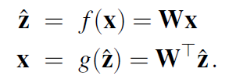

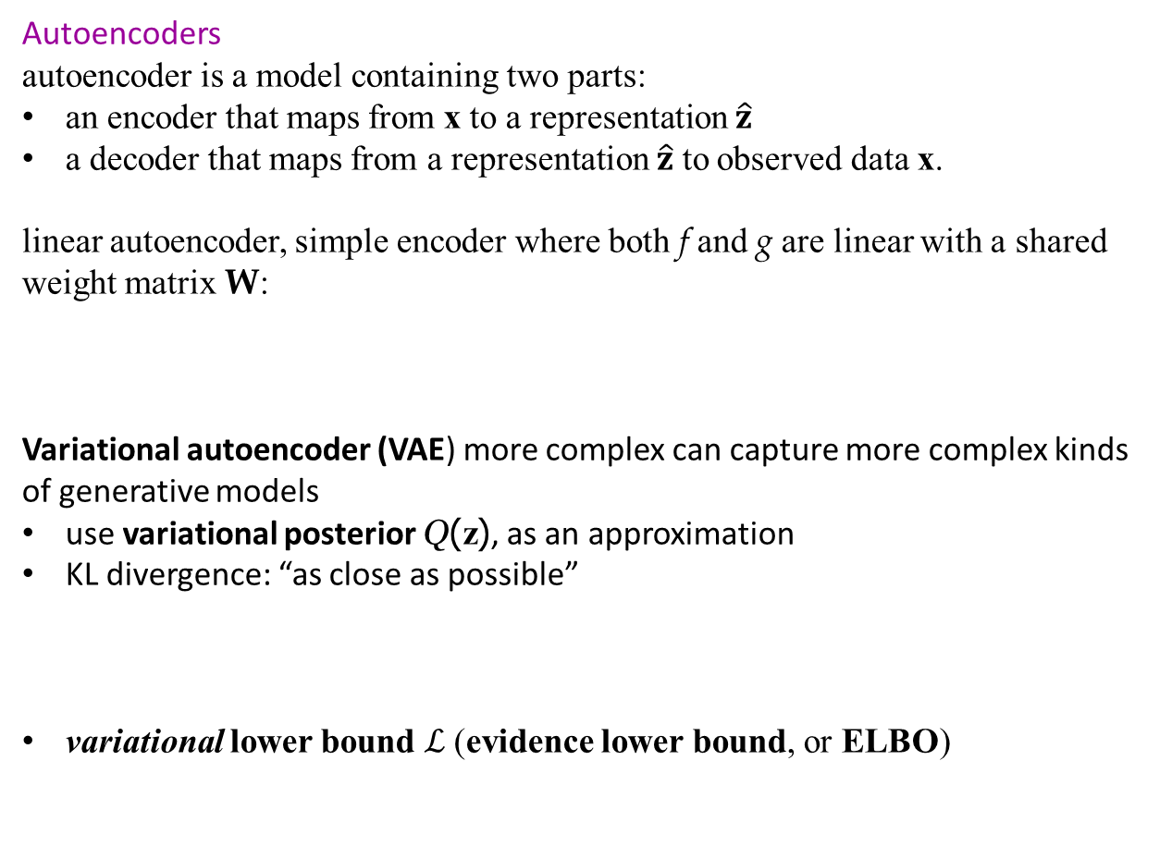
Unsupervised Learning and Transfer Learning
Autoencoders
autoencoder is a model containing two parts:
an encoder that maps from x to a representation $\hat{z}$
a decoder that maps from a representation $\hat{z}$ to observed data x.
linear autoencoder, simple encoder where both f and g are linear with a shared weight matrix W:
Variational autoencoder (VAE) more complex can capture more complex kinds of generative models
use variational posterior Q(z), as an approximation
KL divergence: “as close as possible”
variational lower bound $ℒ$(evidence lower bound, or ELBO)

Slide 30
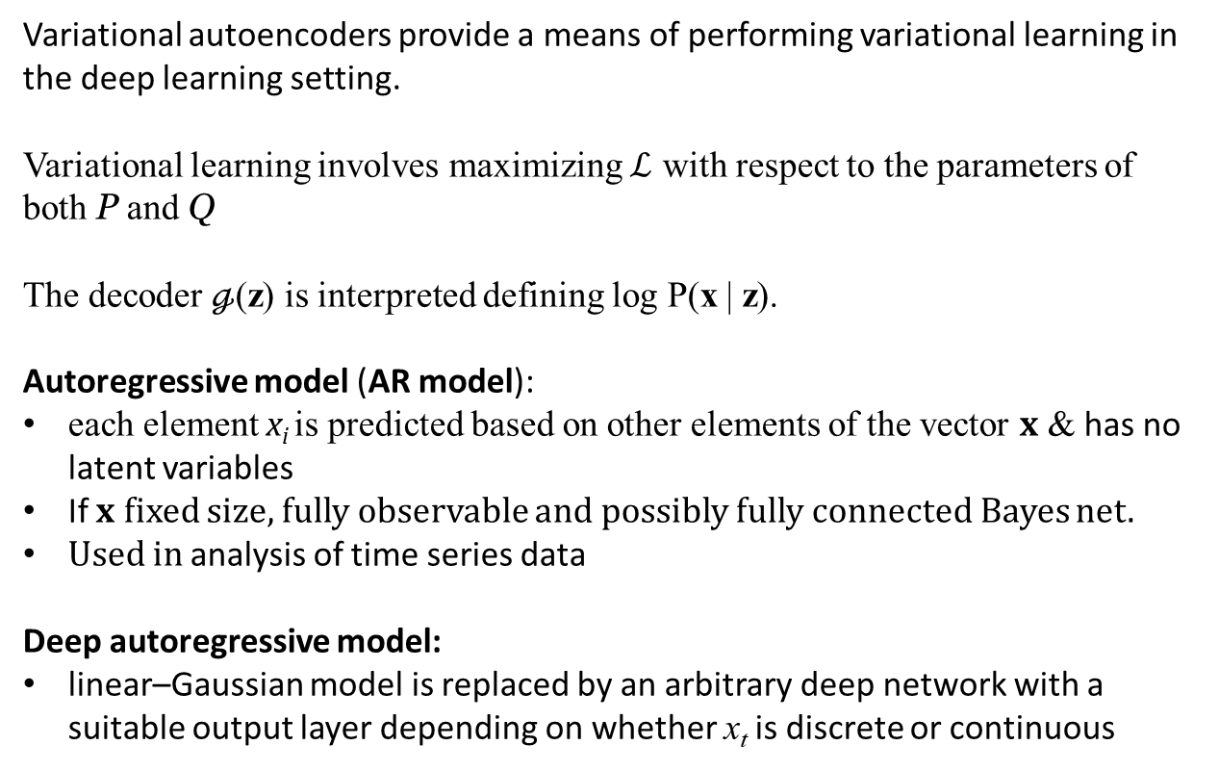
Unsupervised Learning and Transfer Learning
Variational autoencoders provide a means of performing variational learning in the deep learning setting.
Variational learning involves maximizing $ℒ$ with respect to the parameters of both P and Q
The decoder $ℊ$(z) is interpreted defining log P(x | z).
Autoregressive model (AR model):
each element x_{i} is predicted based on other elements of the vector x & has no latent variables
If x fixed size, fully observable and possibly fully connected Bayes net.
Used in analysis of time series data
Deep autoregressive model:
linear–Gaussian model is replaced by an arbitrary deep network with a suitable output layer depending on whether x_{t} is discrete or continuous

Slide 31
Unsupervised Learning and Transfer Learning
Generative adversarial networks
pair of networks that combine to form a generative system
the generator, maps values from z to x
the discriminator, is a classifier trained to classify inputs x as real or fake (generated)
implicit model: samples can be generated but their probabilities are not readily available
generator and the discriminator are trained simultaneously
Generator learning to fool the discriminator and the discriminator learning to accurately separate real from fake data
GANs have worked particularly well for image generation tasks. For example, GANs can create photorealistic, high-resolution images of people who have never existed

Slide 32
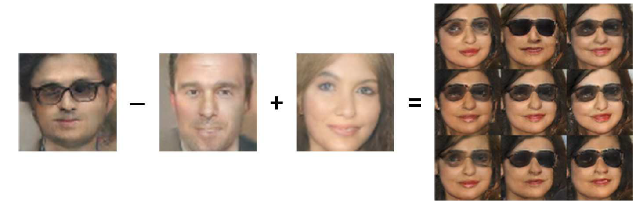
Unsupervised Learning and Transfer Learning
A demonstration of how a generative model has learned to use different directions in z space to represent different aspects of faces. We can actually perform arithmetic in z space. The images here are all generated from the learned model and show what happens when we decode different points in z space. We start with the coordinates for the concept of “man with glasses,” subtract off the coordinates for “man,” add the coordinates for “woman,” and obtain the coordinates for “woman with glasses.” Images reproduced with permission from (Radford et al., 2015).

Slide 33
Unsupervised Learning and Transfer Learning
Transfer learning and multitask learning
For transfer learning experience with one learning task helps an agent learn better on another task
freeze the first few layers of the pretrained model that serve as feature detectors
modify the parameters of the higher levels only
problem-specific features and do classification
Common to start with pretrained model such as the ROBERTA model
Followed by fine-tuning the model in two ways:
giving it examples of the specialized vocabulary used in the desired domain
training the model on the task it is to perform
Multitask learning is a form of transfer learning in which we simultaneously train a model on multiple objectives

Slide 34
Applications
Vision
success of the AlexNet deep learning system in the 2012 ImageNet competition that propelled deep learning into the limelight
supervised learning task with 1,200,000 images in 1,000 different categories
top-5 error rate has been reduced to less than 2%— below error rate of trained human (5%)
Natural language processing
machine translation and speech recognition
end-to-end learning, the automatic generation of internal representations for the meanings of words, and the interchangeability of learned encoders and decoders
end-to-end learning outperforms classical pipelines
re-representing individual words as vectors in a high-dimensional space—so-called word embeddings
Reinforcement learning
decision-making agent learns from a sequence of reward signals that provide some indication of the quality of its behavior
optimize the sum of future rewards
learn a value function, a Q-function, a policy, and so on

Slide 35
Summary
Neural networks represent complex nonlinear functions with a network of parameterized linear-threshold units.
The back-propagation algorithm implements a gradient descent in parameter space to minimize the loss function.
Convolutional networks are particularly well suited for image processing and other tasks where the data have a grid topology.
Recurrent networks are effective for sequence-processing tasks including language modeling and machine translation.

